Slide 3
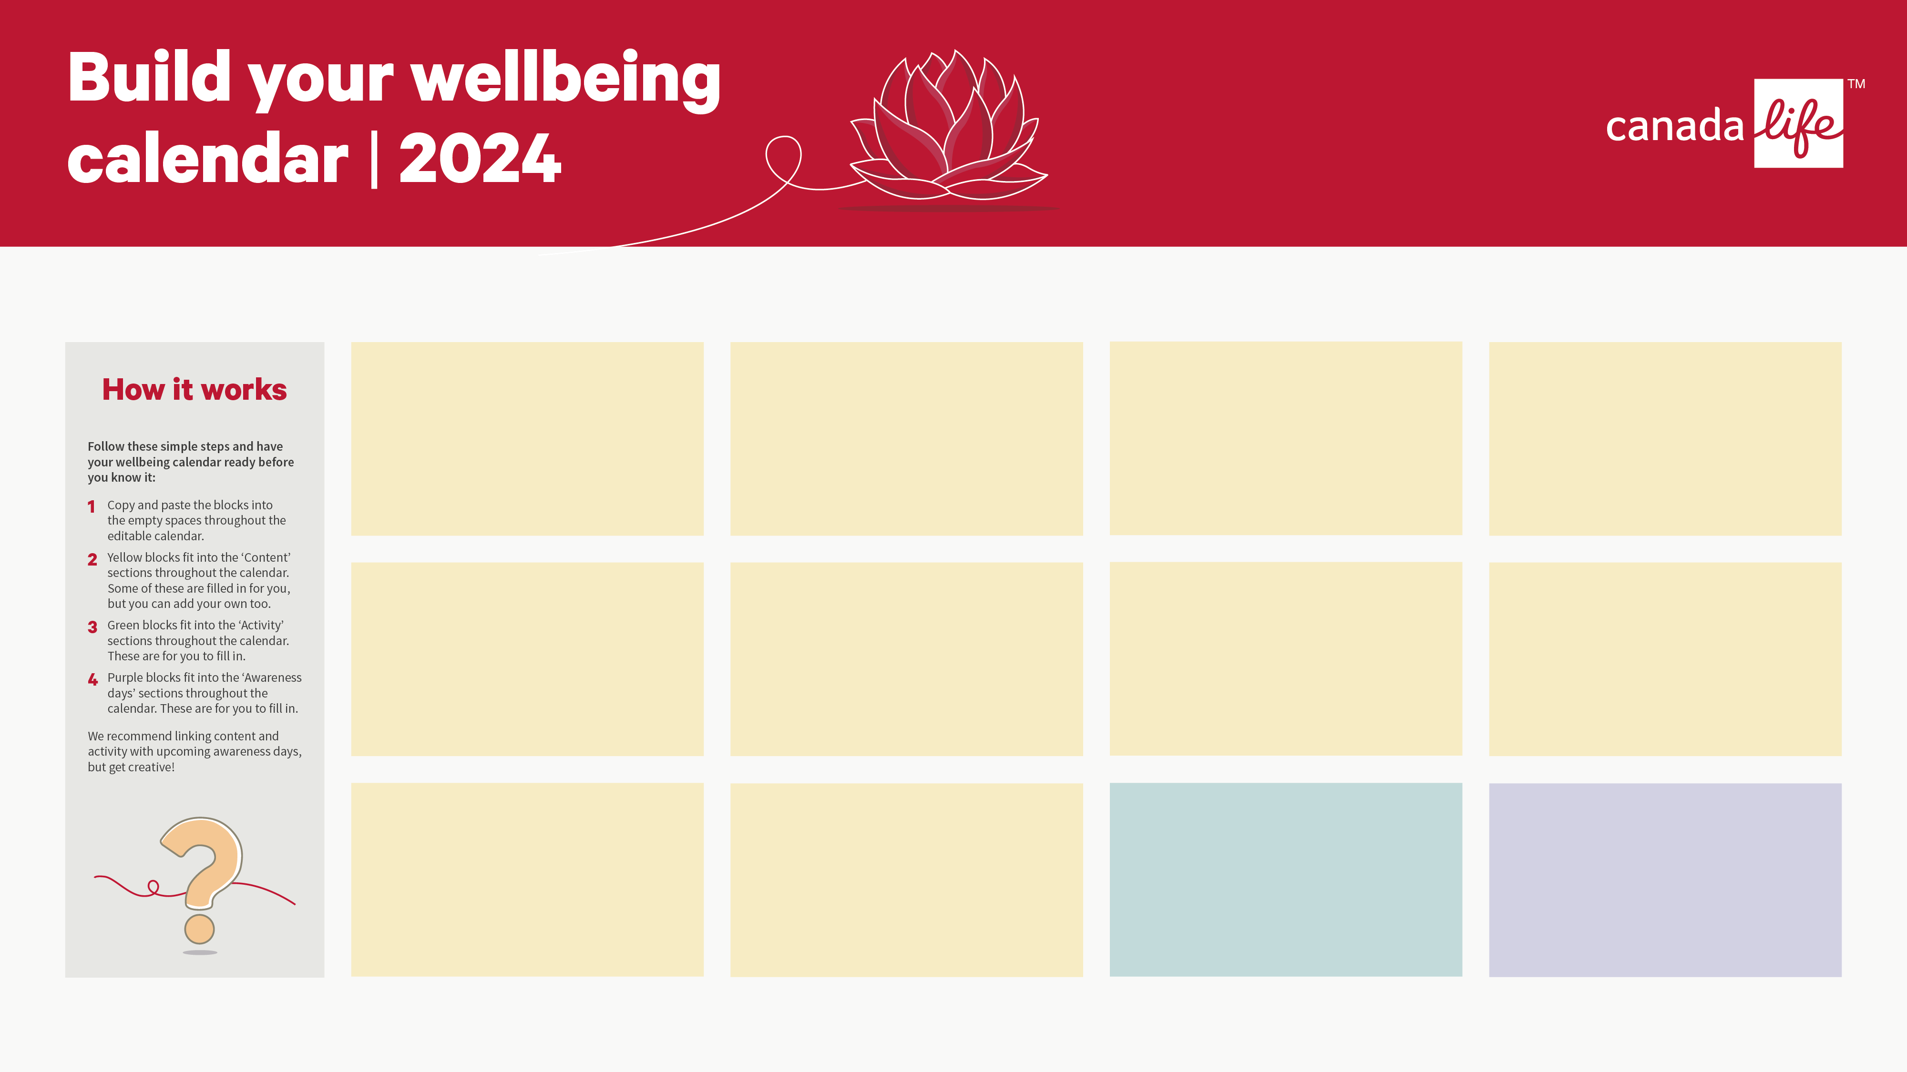
Money makes the world go round
On-demand webinar | 45 mins
As the cost of living increases it’s important to review your financial position.
In this session you’ll learn how to get to grips with your finances, and make the most out of your hard-earned pay cheque - Watch now
Stress resilience toolkit part 1
On-demand webinar | 45 mins
Learn how to spot some key signs of stress before it develops into a bigger issue.
This webinar will teach you how to spot some key signs of stress before it develops into a bigger issue - Watch now
Stress resilience toolkit part 2
On-demand webinar | 45 mins
Building resilience with self-help tools that you can use to help minimise the impacts of stress.
This webinar will provide some self-help tools that you can use to help minimise the impacts of stress - Watch now
8 diet habits to make and break
On-demand webinar | 45 mins
Learn the diet habits we should all make and break.
Join Sarah West, Senior Nutritionist at Teladoc Health UK, to learn the key diet habits we should all make and break - Watch now
Menopause: Line manager toolkit
Article
Helps line managers approach conversations and support team members who are impacted by the menopause.
This toolkit helps line managers approach conversations and support team members who are impacted by the menopause - Access now
Let’s talk about the menopause
Webpage
Building awareness around the menopause is fundamental to normalising the topic.
Access the resources and guidance you need to support your people through the menopause, including guides for HR and line managers - Access now
Working with cancer
On-demand webinar | 45 mins
Learn how to support a return-to-work following cancer.
This webinar could be useful for HR teams, line managers, or people looking to understand how to better support their colleagues - Watch now
Working with cancer
Webpage
More people than ever are surviving cancer, which means that more people are likely to experience cancer in the workplace.
Discover how to support employees through cancer and how to make the most of the support available through our policies - Access now
A Closer Look at Loneliness
Article
Loneliness can be viewed on a spectrum; we can all feel lonely sometimes and that’s normal.
Raising awareness and normalising the subject matter can do so much to help vulnerable people speak up and share how they’re truly feeling – Read more
Mental Health Webinar - Spotting the Signs
On-demand webinar | 35 mins
Designed to teach mental health awareness in the workplace.
This webinar is designed to teach mental health awareness, so you can have more confidence supporting colleagues with a mental health condition in the workplace - Watch now
Planned activity
Add your planned activity below:
Activity 1
Activity 2
Activity 3
Awareness days
Include your chosen days below:
Awareness day 1: Date – Link
Awareness day 2: Date – Link
Awareness day 3: Date – Link
Inspiration can be found here

Slide 4
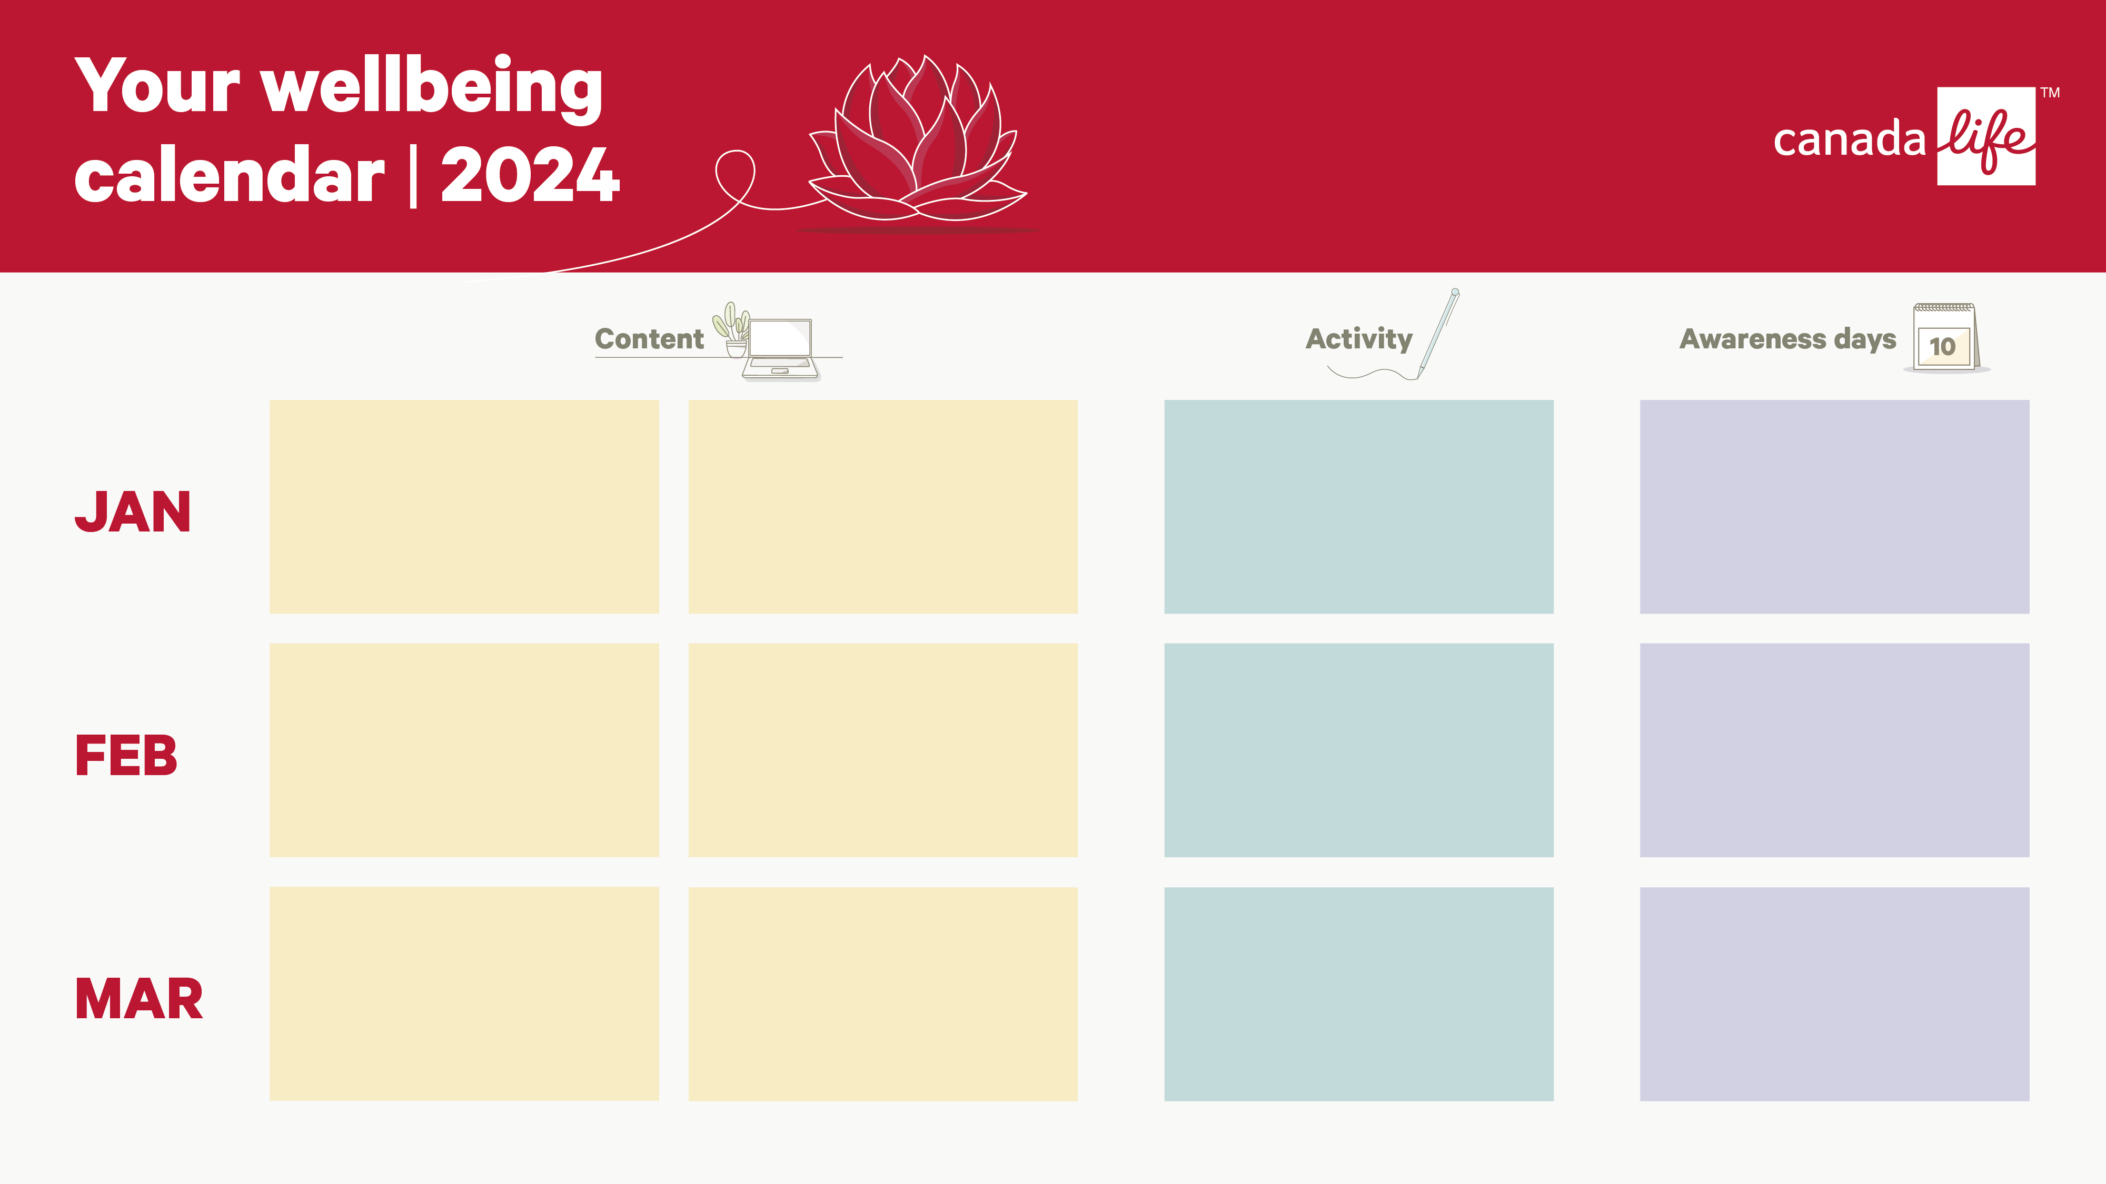

Slide 5
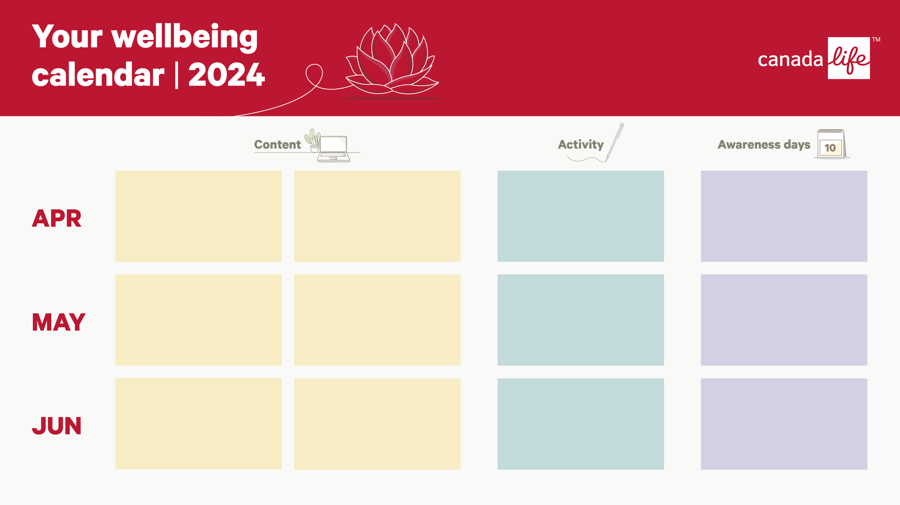

Slide 7
